Slide 1


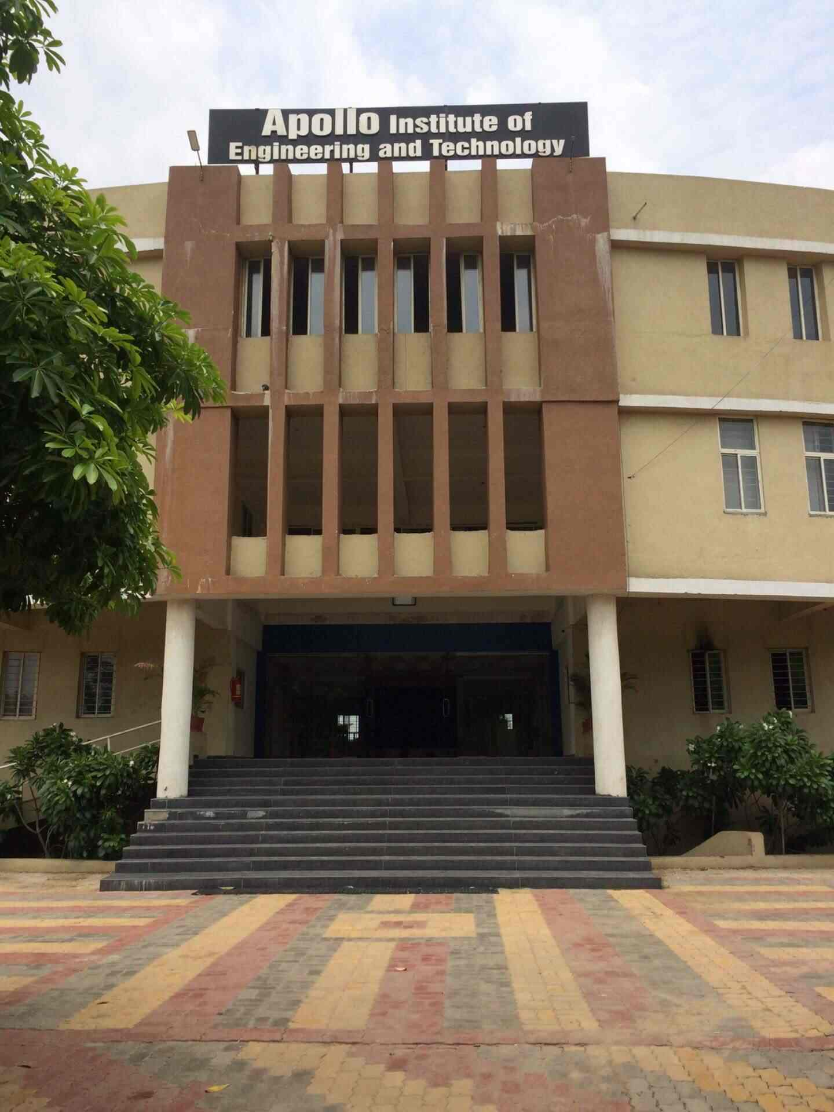
GUJARAT TECHNICAL UNIVERCITY
APOLLO INSTITUTE OF ENGINEERING AND TECHNOLOGY

Slide 2
Name:- Shah Princy R.
Enrollment Number:- 181210116054
Branch:- Information Technology
Semester:- 7
Topic:- Summer Internship
Academic Year:- 2021-2022

Slide 3
Day-1
Introduction about Company…How they working and how they provide internship.
Also introduction about PHP ….like What is PHP , Full-form of PHP, which side PHP is work?, What is requirements to driven successfully PHP in your machine and also introduction about XAMPP and WAMPP server.
They have also tell to create a account in Github.com and we upload every single day work in our account.
Daily code uploded at https://github.com/princy2806/PHP

Slide 4
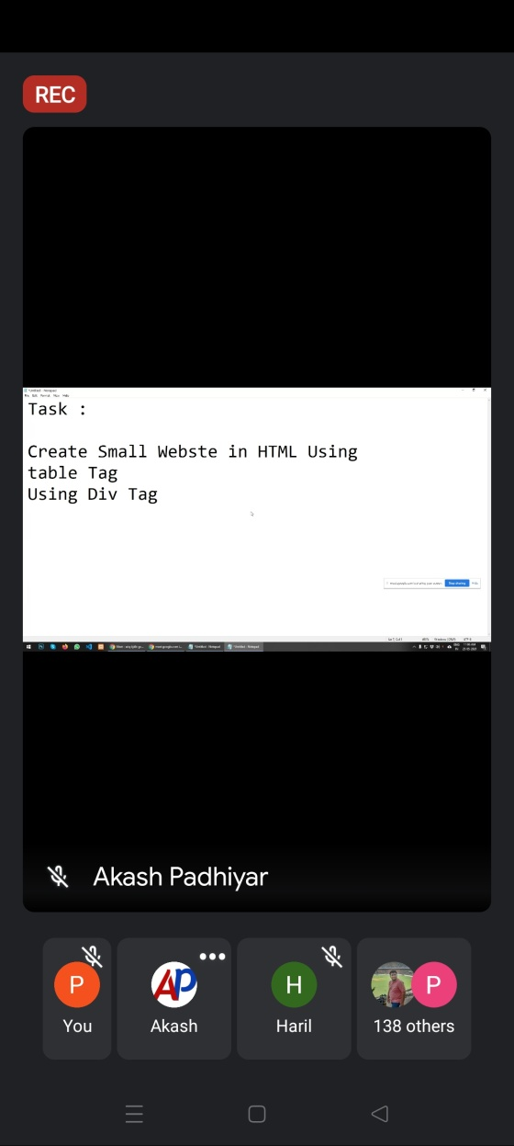
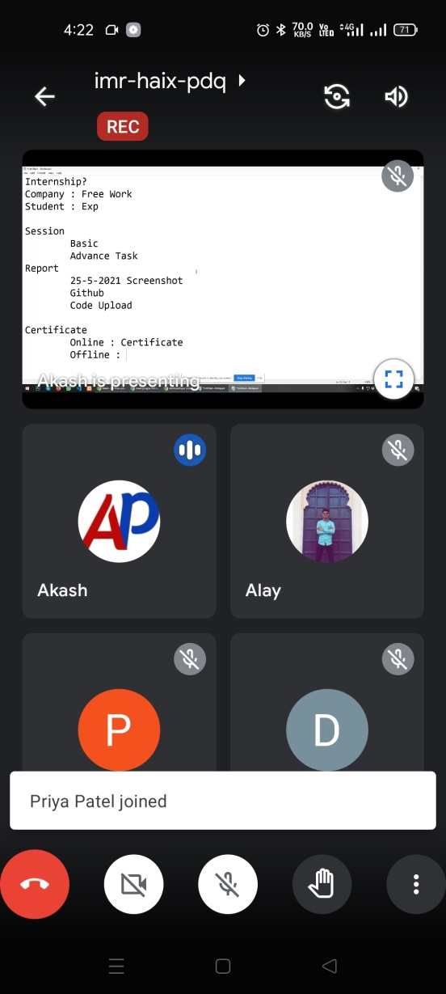
Screenshot of Day-1
Daily code uploded at https://github.com/princy2806/PHP

Slide 5
Day-2
How to print “Hello World” In PHP.
Introduction about different types of IDE which support PHP ..like VScode, Netbeans, sublimeText, Notepad++.
Loop in PHP Ex: switch, if….else, if, while, do-while….
Daily code uploded at https://github.com/princy2806/PHP

Slide 6
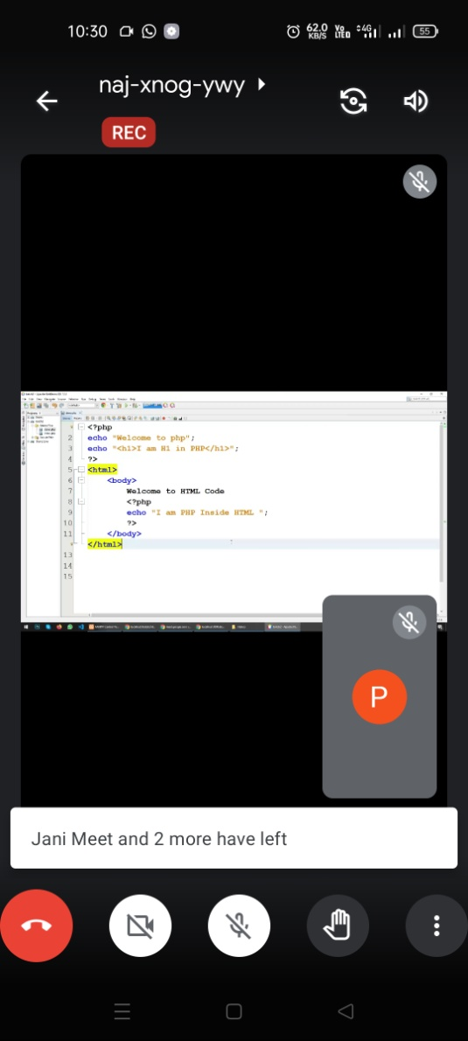
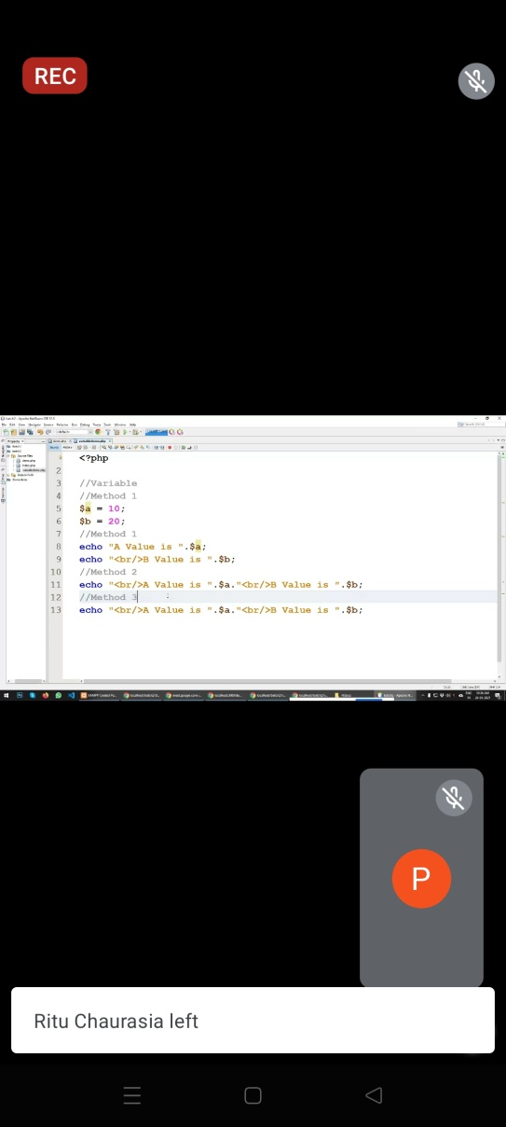
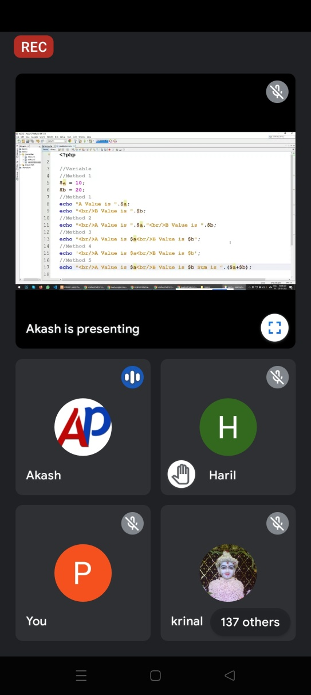
Screenshot of Day-2
Daily code uploded at https://github.com/princy2806/PHP

Slide 7
Day-3
Some example of PHP
Create table using for loop.
Design student result using PHP.
How to get User defined value and How to print using PHP.
Daily code uploded at https://github.com/princy2806/PHP

Slide 8
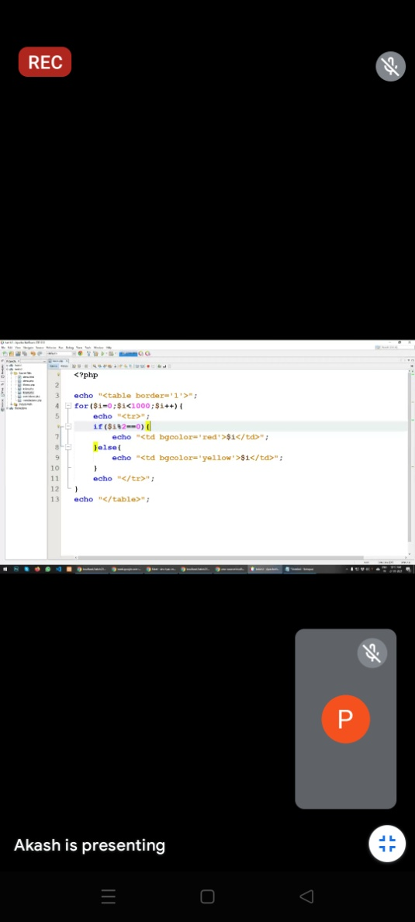
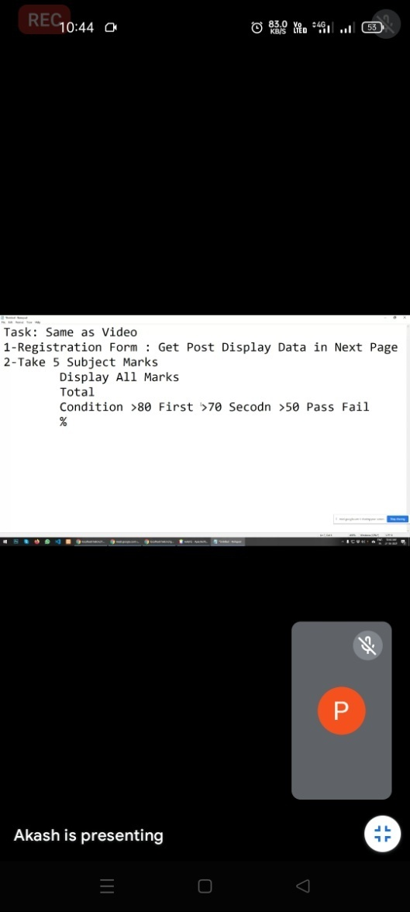
Screenshot of Day-3
Daily code uploded at https://github.com/princy2806/PHP

Slide 9
Day-4
How to make daynamic websit.
Few Pages must include in PHP…like Home page, About us page, Contact page, Gallary page….
How to calculate charge of website.
How to integrate a theme in your website.
Daily code uploded at https://github.com/princy2806/PHP

Slide 10
Day-5
Array in PHP.
Types of Array.
Which loop is used to print Loop.
Function of array.
Daily code uploded at https://github.com/princy2806/PHP

Slide 11
Day-6
Database connectivity in PHP.
How to create database.
How to insert data in database.
Perform insert operation.
Daily code uploded at https://github.com/princy2806/PHP

Slide 12
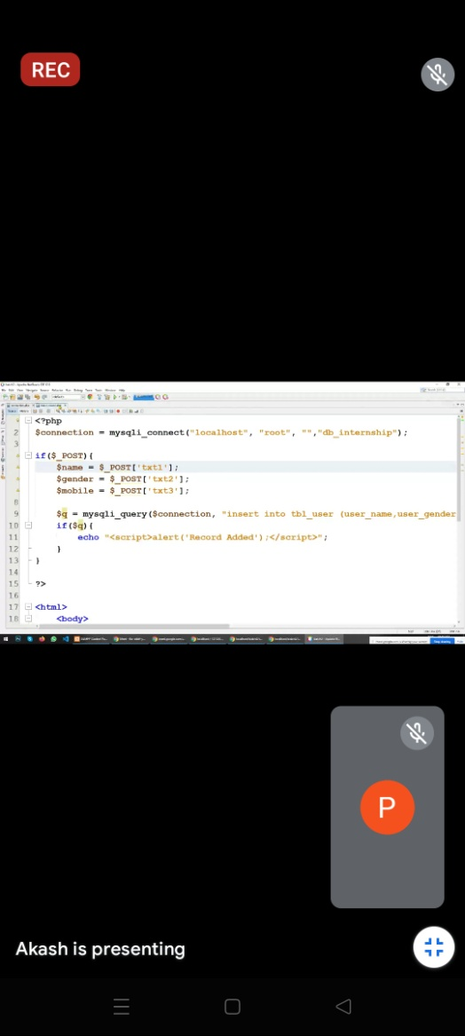
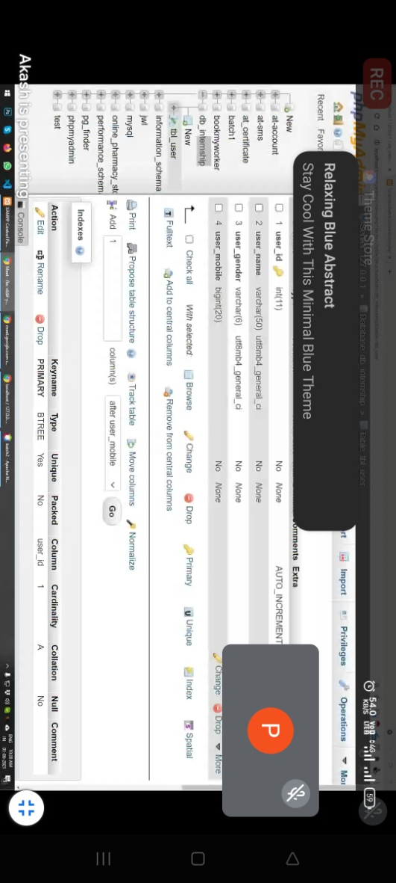
Screenshot of Day-6
Daily code uploaded at https://github.com/princy2806/PHP

Slide 13
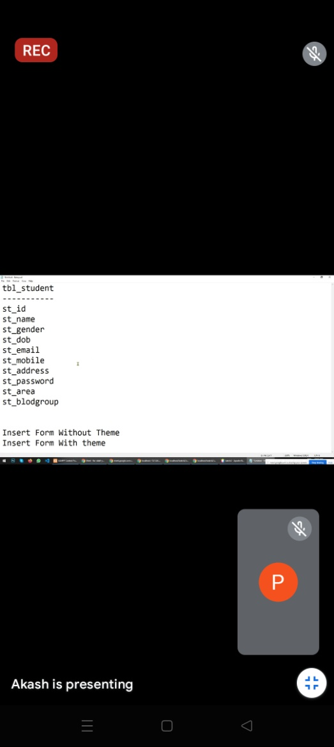
Task of Day-6
Create student table which include following Fields.
Create Student Registration Form with theme and also create Student Registration form without theme
Perform insert Operation in both Form
Daily code uploaded at https://github.com/princy2806/PHP

Slide 14
Day-7
Perform CRUD operation in database.
How to perform soft delete operation. Also learn how big website store their data and how they perform delete operation.
Daily code uploaded at https://github.com/princy2806/PHP

Slide 15
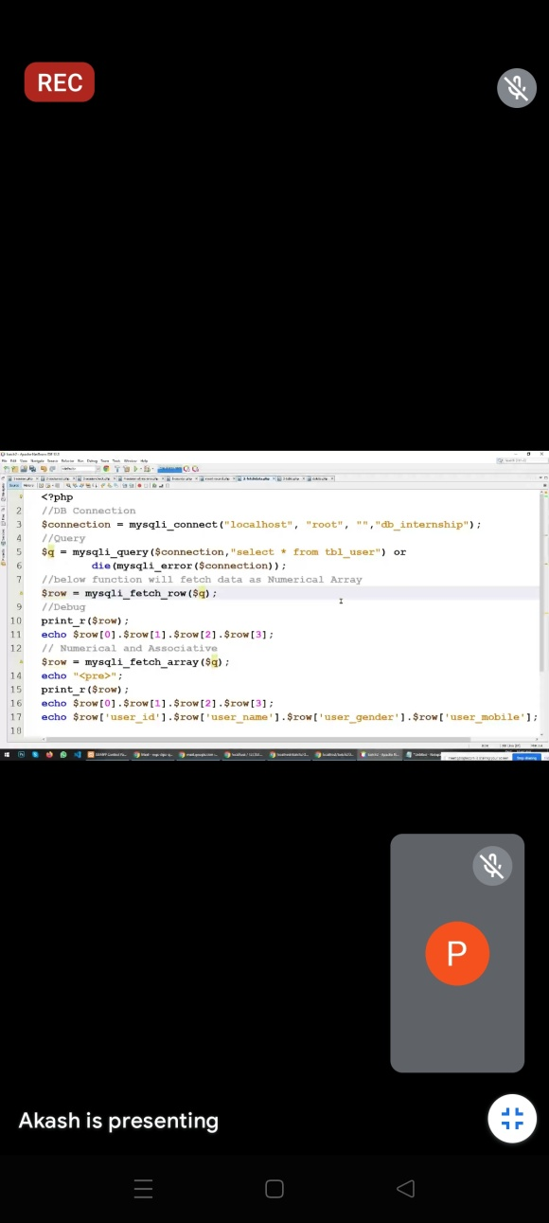
Screenshot of Day-7
Task Perform on Day-7
1) Fetch Data using Mysql Query and print it on FetchData.php page
Daily code uploaded at https://github.com/princy2806/PHP

Slide 16
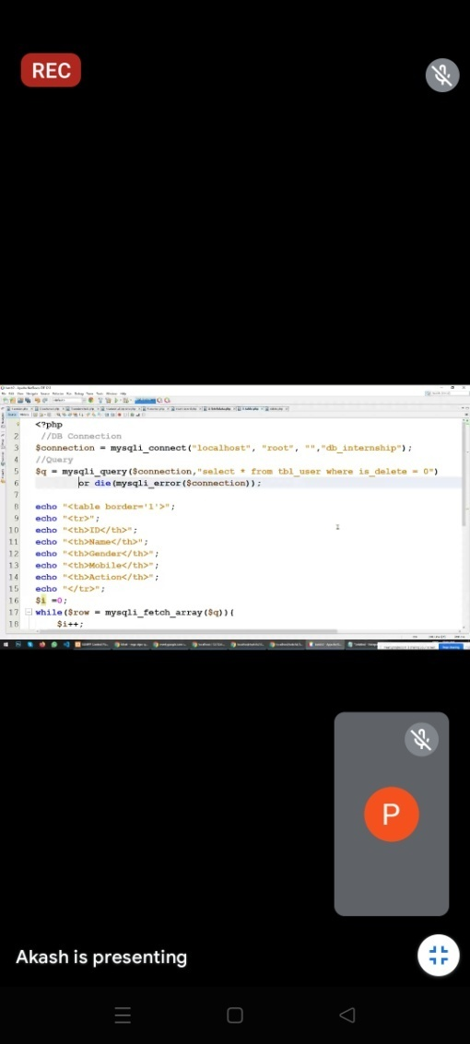
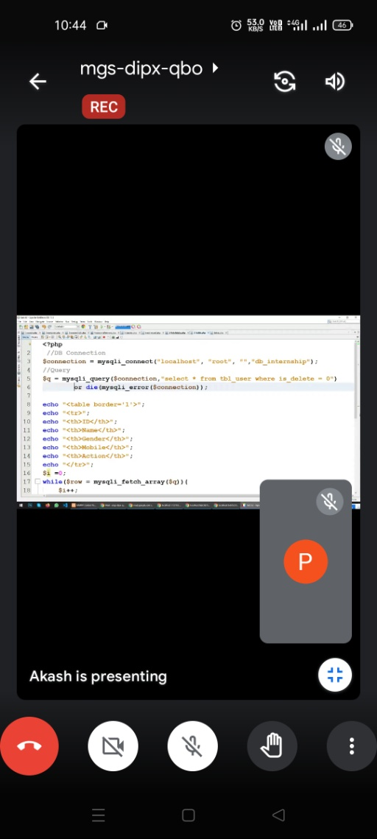
Screenshot of Day-7
Task Perform on Day-7
2) Print Data using Mysql Query and print it on Display.php page
Daily code uploaded at https://github.com/princy2806/PHP

Slide 17
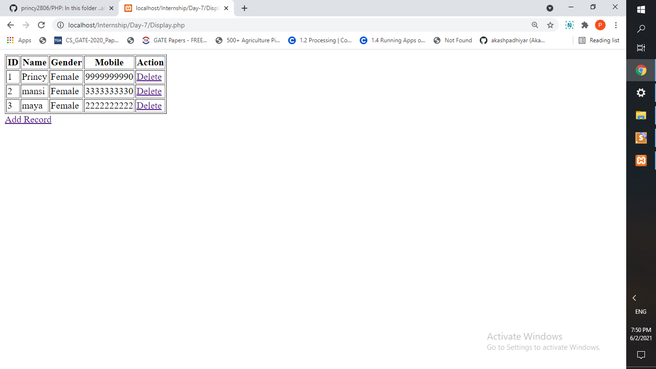
Screenshot of Day-7
2) Input:- Print Data using Mysql Query and print it on Display.php page
Output
Daily code uploaded at https://github.com/princy2806/PHP

Slide 18
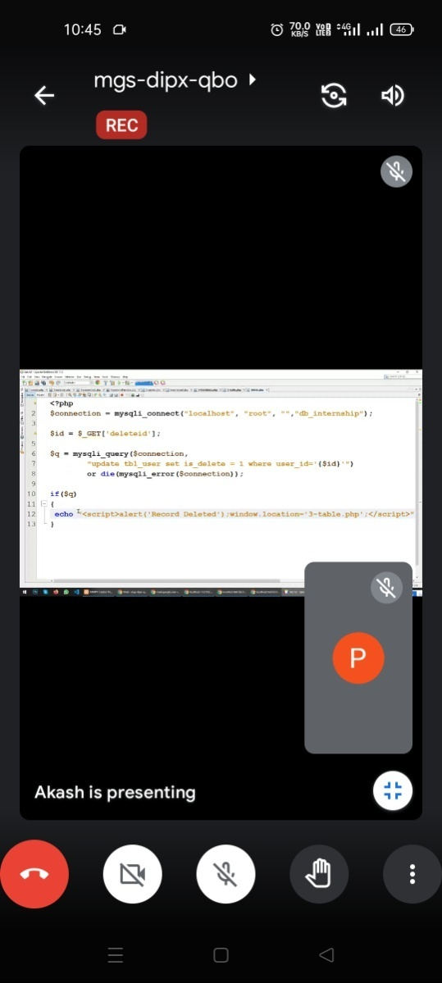

Screenshot of Day-7
Task Perform on Day-7
3) Update Data and also delete data using Mysql Query
Daily code uploaded at https://github.com/princy2806/PHP

Slide 19
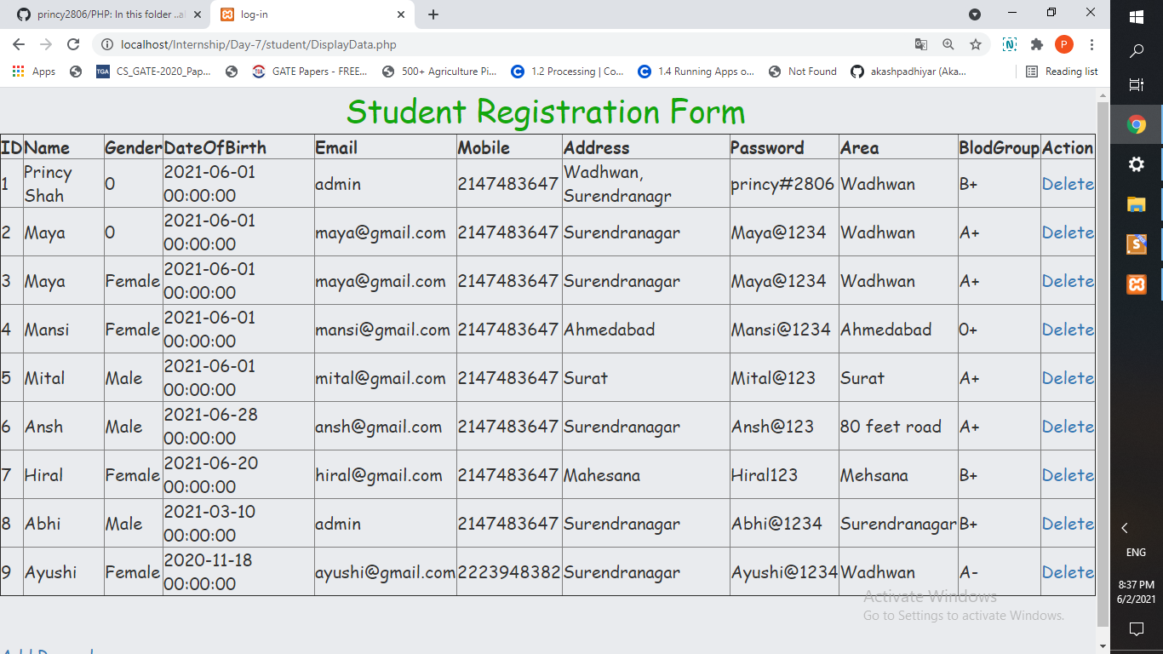
Task of Day-7
Daily code uploaded at https://github.com/princy2806/PHP

